Slide 1
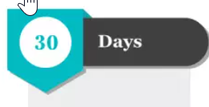
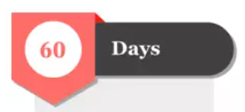
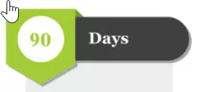
30/60/90 day plan
Name: Yunzhe Li
Leveraging what you already know, and what you have learned in this course to create a plan that will set you up for success as you onboard in a new organization – able to effectively navigate an organization & influence others, via implicit & explicit leadership.
Build tight connections and basic trust with peers and manager
Integrate into the team, contributing to one part of one team project
Establish influence
1. Explore team goals & workflow
2. Demonstrate active engagement
3. Establish clear communication
1. Start to deliver results
2. Seek constructive feedback
1. Lead a Key Project
2. Plan for long-term success
3. Solidify relationships with leadership
1&3 Schedule one-on-one meetings with senior peers and the manager to learn about their roles, goals, and challenges. During these meeting, get familiar with company cultures.
1&2 Review internal documents and attend meetings to gain insights into the current projects.
2 Volunteer for tasks that align with my expertise to show willingness to contribute early on.
1 Identify a project or task where I can apply my skills and make a visible impact.
1&2 Share early achievements with the manager and discuss how these can align with broader team objectives.
2 Ask the manager and colleagues for feedback on contributions and areas where I can improve.
Then reflect on the feedback and make adjustments to approach as needed.
1 Take ownership of a project aligned with both expertise and the organization’s strategic goals. Set timelines, deliverables, and memeber to be engaged in detail. Regularly update on progress.
2 Schedule a strategic meeting with the manager to discuss long-term goals and growth chances.
3 Begin mentoring junior/intern team members, showing leadership and commitment to team development.

Slide 2
externalize your thinking
Why did you choose to tackle the objective in the 1st 30 days first?
I chose to focus on developing connections and basic trust within the first 30 days because connections and trust are the foundation for effective collaboration and influence. Trust takes time to build, so trying to build trust early on will allow me to integrate smoothly into the team. Additionally, by connecting with peers with humility can help me actively understand the team’s dynamics, then quickly align myself with the company’s culture, values, and shared expectations, making it easier to achieve my long-term objectives.
What are a couple of opportunities you chose to leave out of your priorities/focus, and why?
I chose to leave out the focus of trying to know everything about the team. While this could enhance my understanding of how our team organizes and foster better collaboration through empathy, it would require a considerable amount of time that can be used to focus on other areas to maximize outcomes. Additionally, I chose not to prioritize expanding my internal network. Although networking is important from day one, aggressively expanding my network too early might be overwhelming or perceived as premature. I believe that after 90 days, when I have a better understanding of the key players, I can strategically build relationships beyond my immediate team.

